Slide 1


Computational Intelligence (TC2027)

Slide 2
Unit 5 – System Security (VII)
What are Surface Web, Deep Web, and Dark Web?
Dark Web
Tor

Slide 3
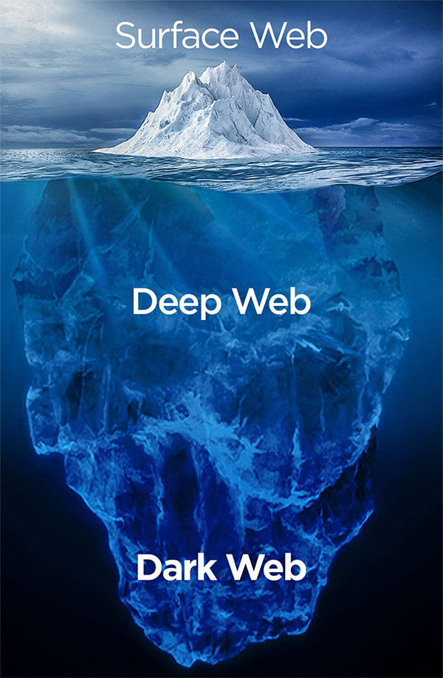
What is Surface Web, Deep Web, and Dark Web?

Slide 4
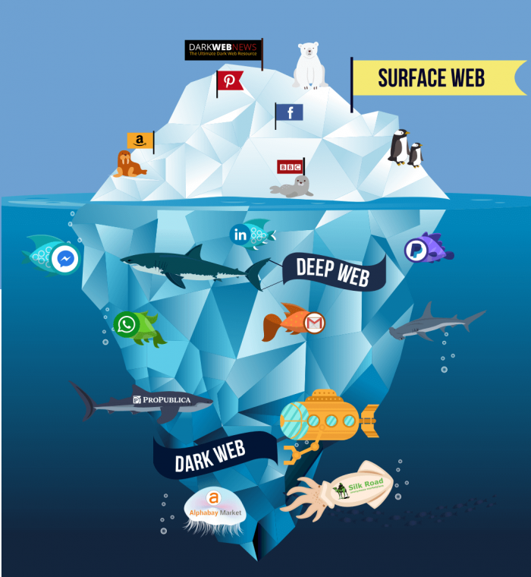
Surface Web
The Surface Web has been part of the World Wide Web since the first browser was first invented in 1990 by Tim Berner-Lee and is the part of the web you will be most familiar with, as it anything that can be discovered through your internet browser using any of the main search engines (Google, Bing, Yahoo etc.).

Slide 5





Surface Web
This is what you use when you read the news, buy something on Amazon, or visit any of your usual daily websites, and is also the area of the web that is under constant surveillance by governments across the world.
Making up under 5 percent of the total World Wide Web content that is known to exist is a figure that is already miniscule but estimates suggest that the Deep Web could be anywhere from 500 to 5000 times larger.

Slide 6
Deep Web
The Deep Web was also part of the web at its conception, and in basic terms it is the opposite of the surface as it anything that search engines cannot find.
This is the key difference between the two in real data terms; sites on the surface internet are indexed for search engines to find, but the deep web is not indexed.
However, both are also accessible by the public, they just require different methods to access them - usually a specific password encrypted browser or a set of log in details.

Slide 7
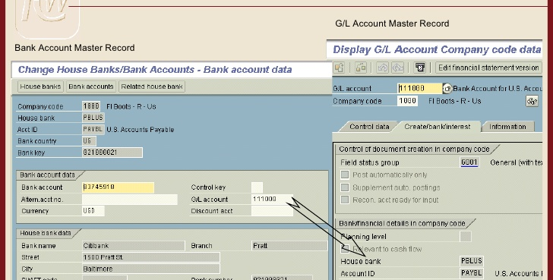

Deep Web
Deep Web contains all our medical records, financial records, social media files, and plenty other important information we want and need to keep secure.
It is this need to keep secure files that gave rise to the need to keep a portion of the web secured away from being "Googled" at the whim of anybody at any time.

Slide 8
Dark Web
The Dark Web IS part of the Deep Web, but it has one major difference in that it has been intentionally hidden and is inaccessible to normal web browsers.

Slide 9


Dark Web
The technology to create the Dark Web was initially created (and still funded) by US Military Researchers in the mid-1990s to allow spies and intelligence agencies to anonymously send and receive messages.
Named "The Onion Router", it was quickly coined with the shorter "Tor" with its name coming from application layer encryption within a communication protocol stack; many layers representing the layers of an onion.

Slide 10
Surface Web
Accessible
Deep Web
Accessible by password, encryption, or through gateway software
Dark Web
Restricted to special browsers
Indexed for Search Engines
Little illegal activity
Relatively small
Not indexed for Search Engines
Little illegal activity outside of Dark Web
Huge in size and growing exponentially
Not indexed for Search Engines
Large scale illegal activity
Unmeasurable due to nature

Slide 11
Dark Web

Slide 12
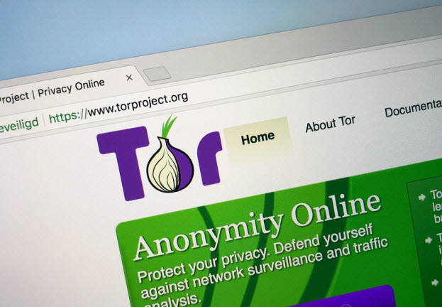
Dark Web
The Dark Web, also known as Darknet websites, are accessible only through networks such as Tor ("The Onion Routing" project) that are created specifically for the Dark Web,
Tor browser and Tor-accessible sites are widely used among the darknet users and can be identified by the domain ".onion".
Tor browsers create encrypted entry points and pathways for the user, allowing their Dark Web searches and actions to be anonymous.
Identities and locations of darknet users stay anonymous and cannot be tracked due to the layered encryption system.

Slide 13

Dark Web Anonymity
This anonymity also creates a forum for illegal activity which is what the Dark Web is most associated with.
Authorities have reported the trade of child pornography, drug related crime, illegal financing of pornography relating to children, violence, and animals; as terrorism.
A Dark Web market-place, also known as a crypto-market, operates by selling illegal goods such as drugs, weapons, and financial fraud related products and information

Slide 14
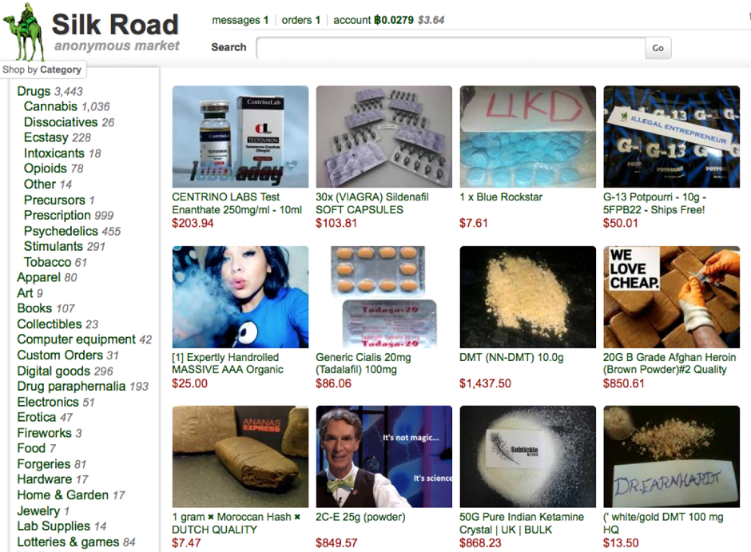
Silk Road
Silk Road was an online black market and the first modern darknet market, best known as a platform for selling illegal drugs.
The website was launched in February 2011; development had begun six months prior.

Slide 15
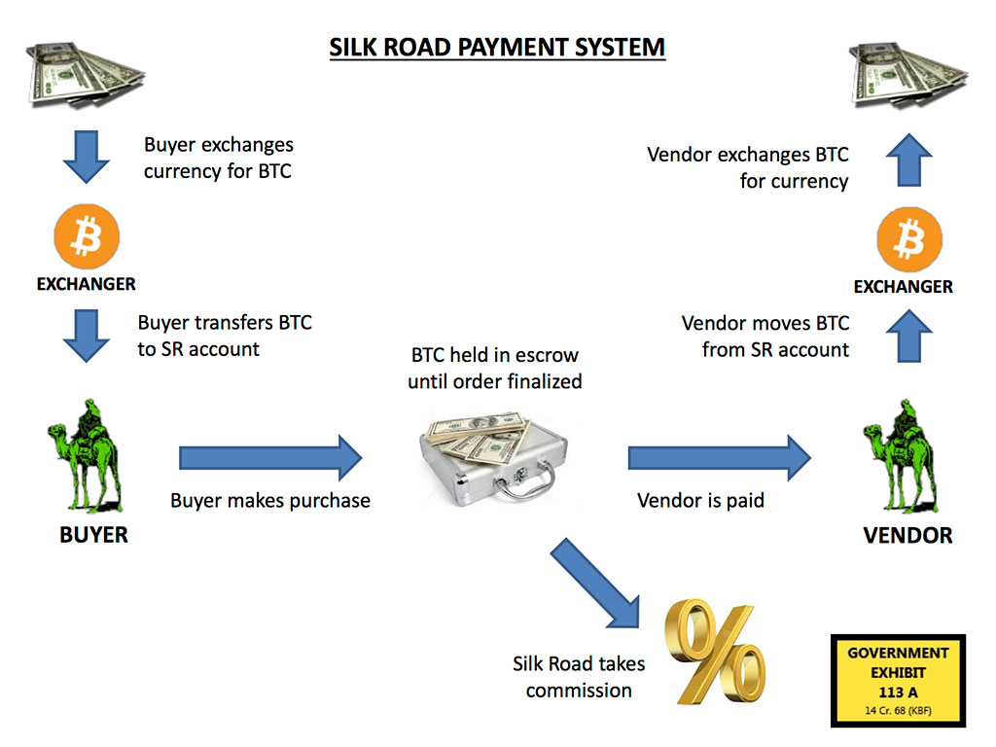
Silk Road

Slide 16

Silk Road
In October 2013, the FBI shut down the website and arrested Ross Ulbricht under charges of being the site's pseudonymous founder "Dread Pirate Roberts".
On 6 November 2013, Silk Road 2.0 came online, run by former administrators of Silk Road.
It was also shut down, and the alleged operator was arrested on 6 November 2014 as part of the so-called "Operation Onymous".
Ulbricht was convicted of seven charges related to Silk Road in the U.S. Federal Court in Manhattan and was sentenced to life in prison without possibility of parole.
In November 2020, the United States government seized more than $1 billion worth of bitcoin connected to Silk Road

Slide 17
Tor

Slide 18
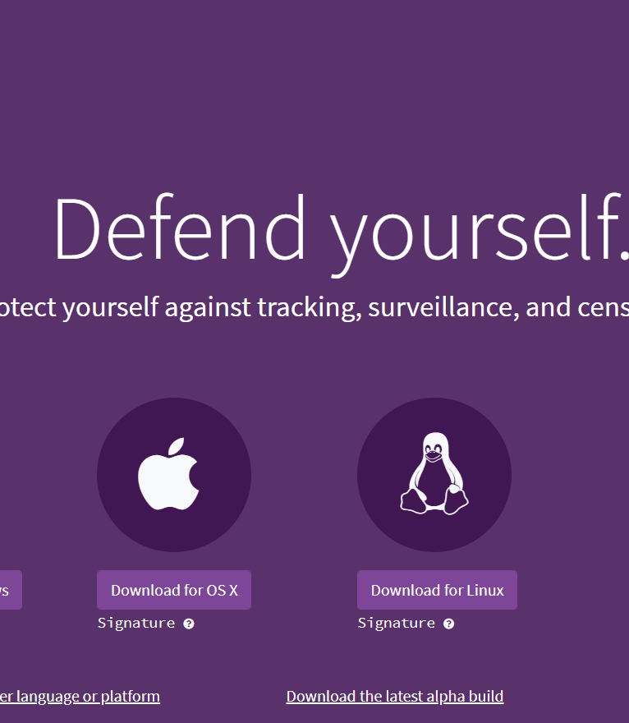
What is Tor?
The Tor Browser is a web broswer that anonymizes your web traffic using the Tor network, making it easy to protect your identity online.
Tor Browser is available for Linux, Mac, Windows, and Android.
If you're iOS users can grab OnionBrowser from the Apple App Store.
https://www.torproject.org/download/

Slide 19
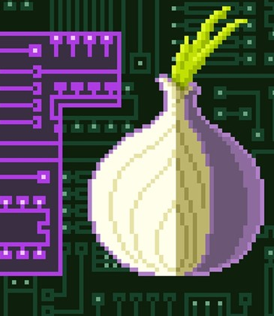
How does Tor work?
Tor consists of a three-layer proxy (like layers of an onion).
Tor Browser connects at random to one of the publicly listed entry nodes, bounces that traffic through a randomly selected middle relay, and finally spits out your traffic through the third and final exit node.

Slide 20
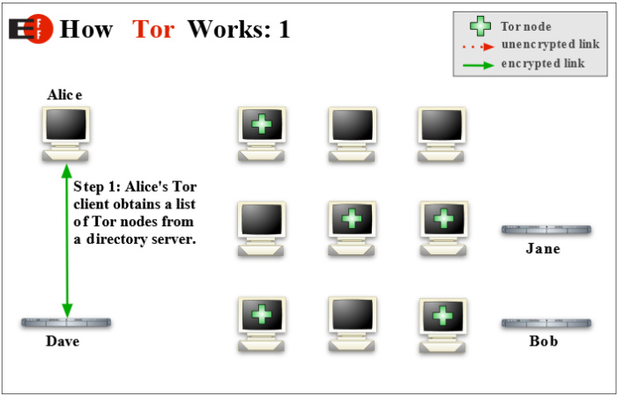

Slide 21
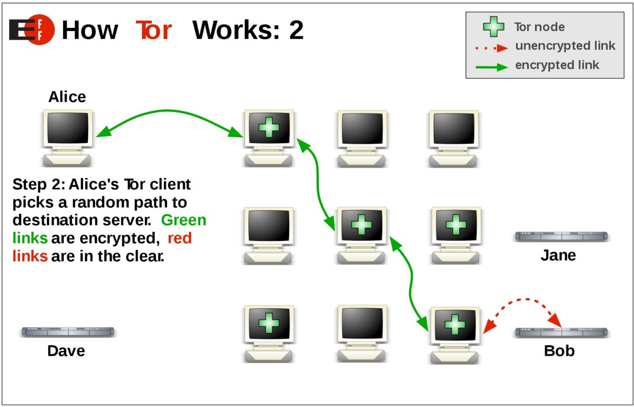

Slide 22
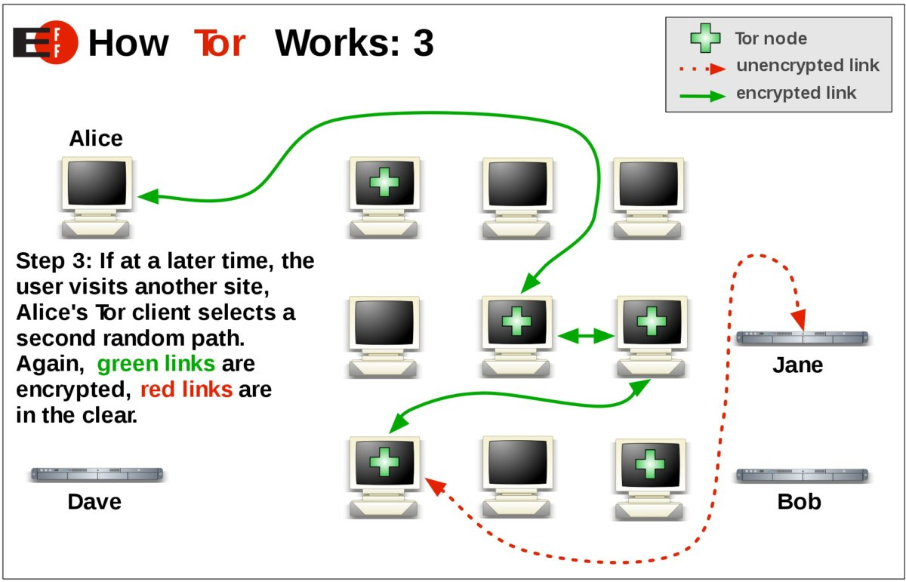

Slide 23
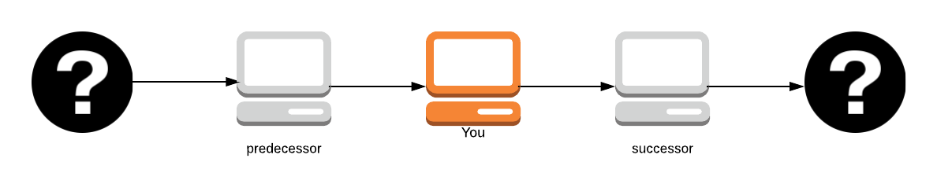
Onion Routing
Onion Routing is a distributed overlay network designed to anonymize TCP-based applications like web browsing, secure shell and instant messaging.
Clients choose a path through the network and build a circuit where each onion router in the path knows the predecessor and the successor, but no other nodes in the circuit. Paths and circuits are synonyms.

Slide 24
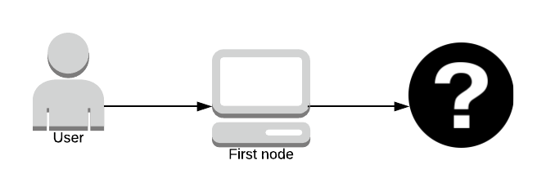
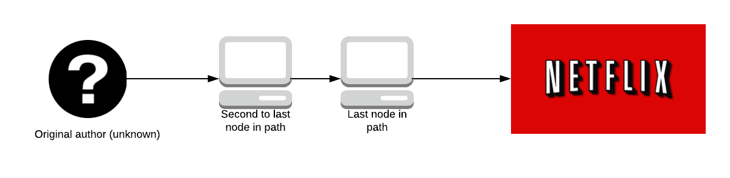
Onion Routing
The original author (the question mark on the far left) remains anonymous, unless you’re the first path in the node as you know who sent you the packet.
No one knows what data is being sent until it reaches the last node in the path; who knows the data but doesn’t know who sent it. The second to last node in the path doesn’t know what the data is, only the last node in the path does.

Slide 25
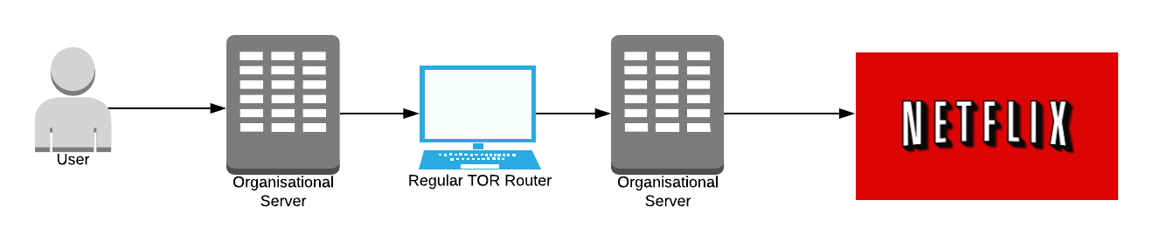
Onion Routing
This has led to attacks whereby large organizations with expansive resources create Tor servers which aim to be the first and last onion routers in a path. If the organization can do this, they get to know who sent the data and what data was sent, effectively breaking Tor.
It’s incredibly hard to do this without being physically close to the location of the organization's servers, we’ll explore this more later.

Slide 26
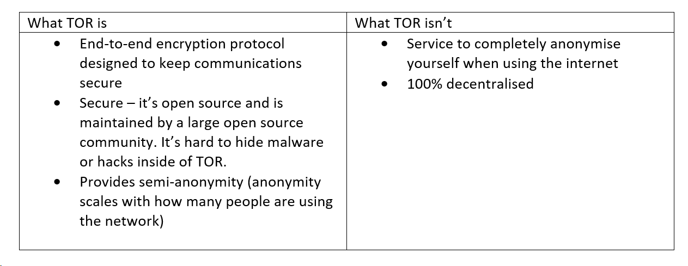

Slide 27
How Is a Circuit Created?
Each machine, when it wants to create a circuit, chooses the exit node first, followed by the other nodes in the circuit.
Tor circuits are always 3 nodes.
Increasing the length of the circuit does not create better anonymity. If an attacker owns the first and last nodes in the network, you can have 1500 nodes in the circuit, and it still wouldn’t make you more secure.

Slide 28
Selection of Exit Node
Does the client’s torrc (the configuration file of Tor) have settings about which exit nodes not to choose?
Tor only chooses an exit relay which allows you to exit the Tor network. Some exit nodes only allow web traffic (HTTP/S port 80) which is not useful when someone wants to send email (SMTP port 25).
The exit node must have the available capacity to support you. Tor tries to choose an exit node which has enough resources available.

Slide 29
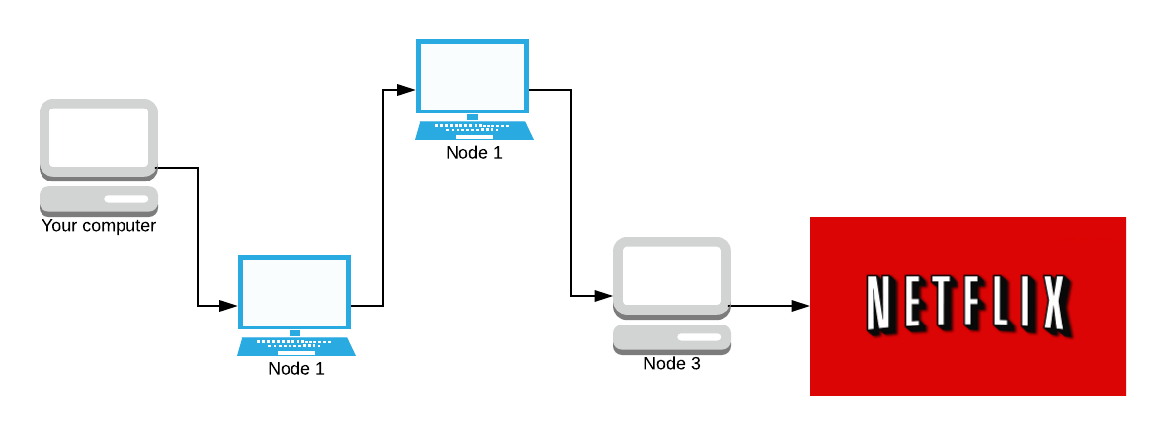
Selection of Exit Node
We do not choose the same router twice for the same path: If you choose the same node twice, it’s guaranteed that the node will either be the guard node (the node you enter at) or the exit node, both dangerous positions. There is a 2/3 chance of it being both the guard and exit nodes, which is even more dangerous.

Slide 30
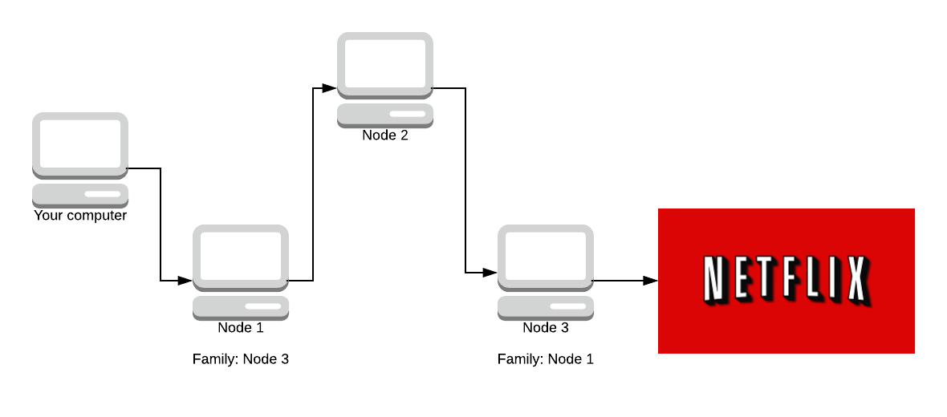
Selection of Exit Node
We do not choose any router in the same family as another in the same path: Two routers are in the same family if each one lists the other in the “family” entries of its descriptor.

Slide 31
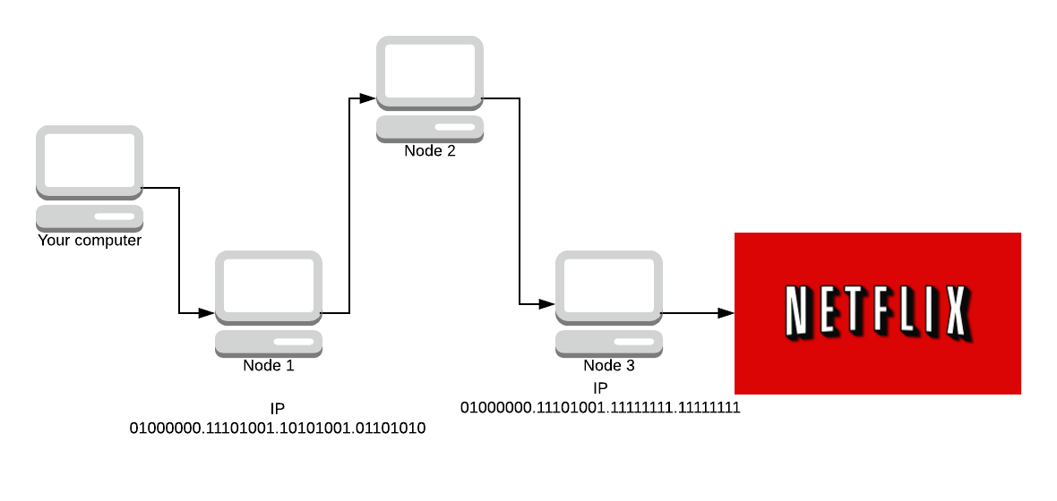
Selection of Exit Node
We do not choose more than one router in a given /16 subnet.

Slide 32
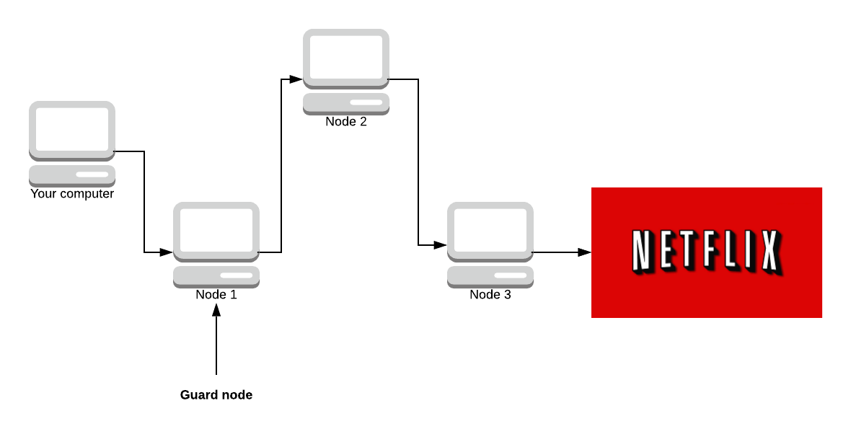
Selection of Exit Node
The first node must be a Guard node: A guard node is a privileged node because it sees the real IP of the user. It’s ‘expensive’ to become a guard node (maintain a high uptime for weeks and have good bandwidth).

Slide 33
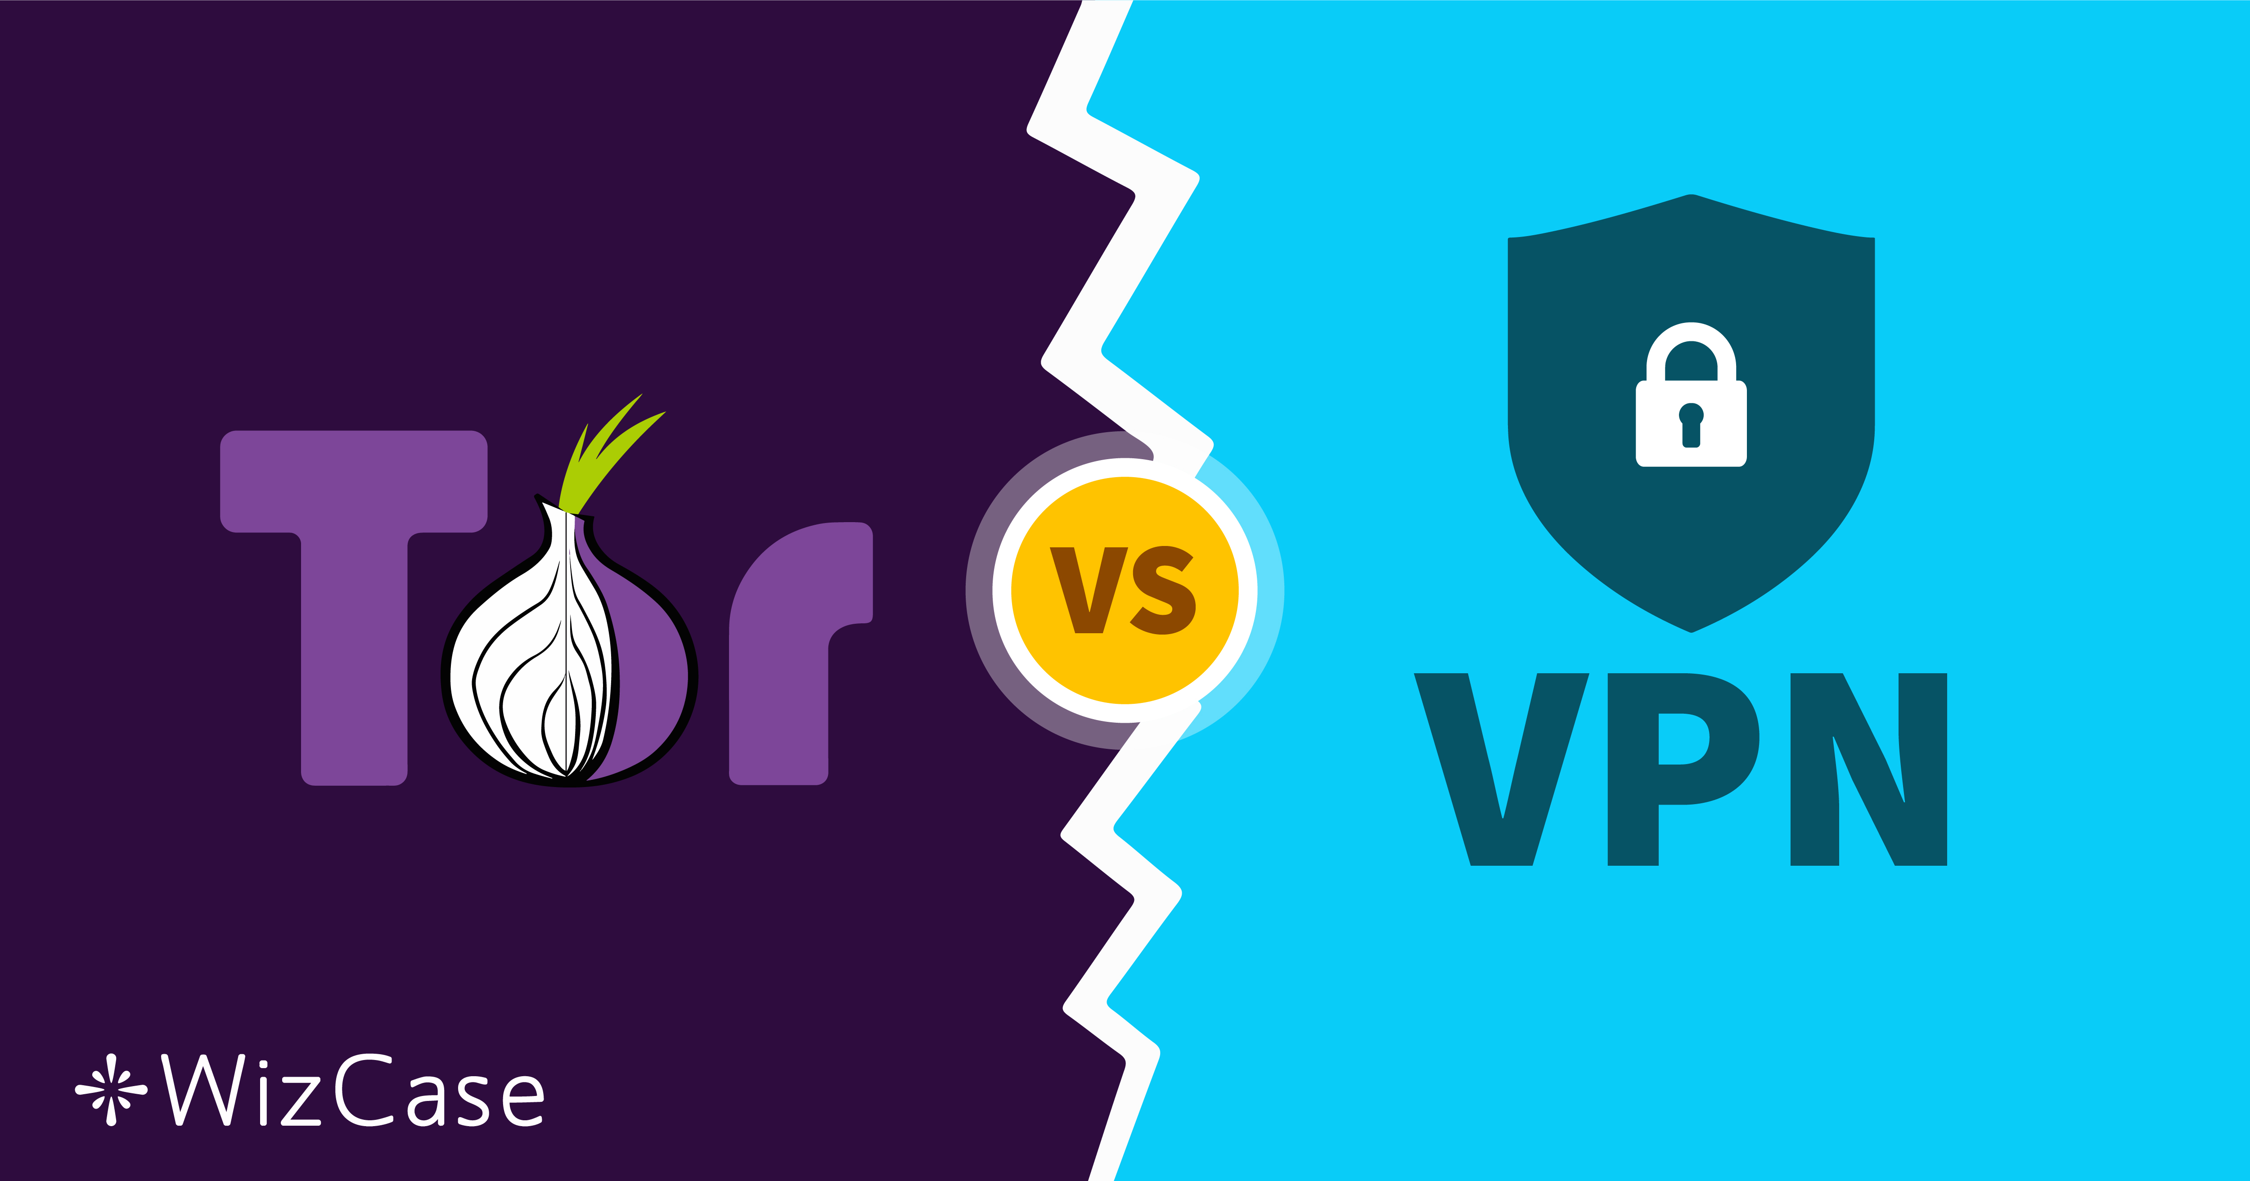
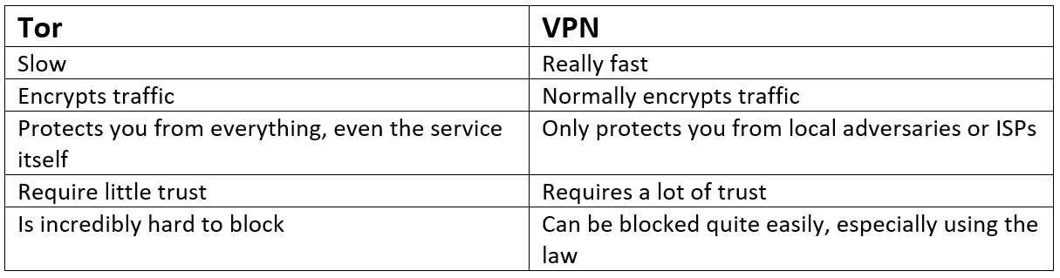

Slide 34
Tor Hidden Services
Tor hidden services work within the Tor network and allow you to register an internal, Tor-only service that gets its own .onion hostname.
Unlike with other services though, hidden services provide two-way anonymity:
The server doesn't know the IP of the client, like with any service you access over Tor,
The client also doesn't know the IP of the server.
This provides the ultimate in privacy since it's being protected on both sides.

Slide 35
Unit 5 – System Security (VII)
What are Surface Web, Deep Web, and Dark Web?
Dark Web
Tor

Slide 36
Computational Intelligence (TC2027)

